Slide 1
○ | 의사결정
● | 정보전달
○ | 지시사항
GMES CDC Daily Check List
2016. 3.7
Global MES Team
Notes:
1

Slide 2
Index
1. Process Running
2. Process Status
3. Capture Process
4. Read Process
5. Export Process
6. Import Process
7. Post Process
8. Queue
9. Sync
Notes:
응용 프로그램의 가용성과 확장성을 향상시킵니다
고가용성
가용성이 높은 시스템은 가동 중지 시간을 최소화하면서 적절한 수준의 서비스를 안정적으로 제공합니다. NLB에는 고가용성을 제공하기 위해 다음 작업을 자동으로 수행할 수 있는 기본 제공 기능이 포함되어 있습니다.
실패했거나 오프라인 상태가 된 클러스터 호스트 검색 및 복구 호스트가 추가 또는 제거될 때 네트워크 부하 분산 10초 내에 복구 및 작업 부하 재 분산
부하 분산 응용 프로그램의 경우 특정 호스트가 실패하거나 오프라인 상태가 되면 아직 작동 중인 컴퓨터 간에 부하가 자동으로 다시 분산됩니다
특정 컴퓨터가 예기치 않게 실패하거나 오프라인 상태가 되면 실패했거나 오프라인 상태인 서버의 활성 연결이 끊어집니다.

Slide 3
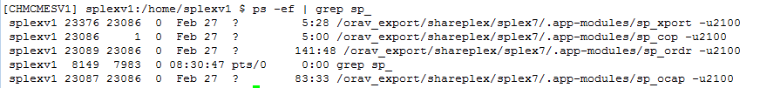
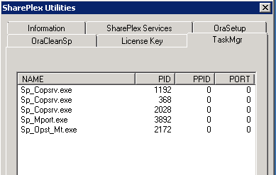
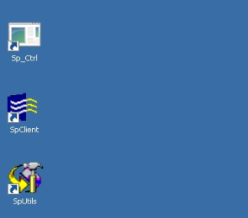
1. Process Running
Check Item | Details | Result
Process Running (Source) | $ ps -ef | grep sp_ | OK
Process Running (Target) | Check Target CDC Process → SpUtils | [ OK ]
 | • Check the state column: Running / Idle(waiting for data to process) / Stopped by a user / Stopped because of an error

Slide 4
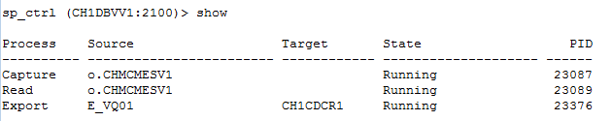

2. Process Status
Check Item | Details | Result
Process Status (Source) | sp_ctrl(source) > show | [ OK ]
Process Status (Target) | sp_ctrl(target) > show | [ OK ]

Slide 5
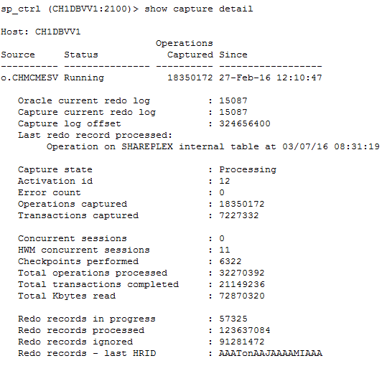
3. Capture Process
Check Item | Details | Result
Capture Process (Source) | sp_ctrl(source) > show capture detail | [ OK ]
 | • 'Oracle Current Redo Log' and 'Capture Current Redo Log' must be same • If 'Oracle Current Redo Log' is more than 'Capture Current Redo Log', the Capture Process is reading the archive log, Monitoring is required to be same.

Slide 6
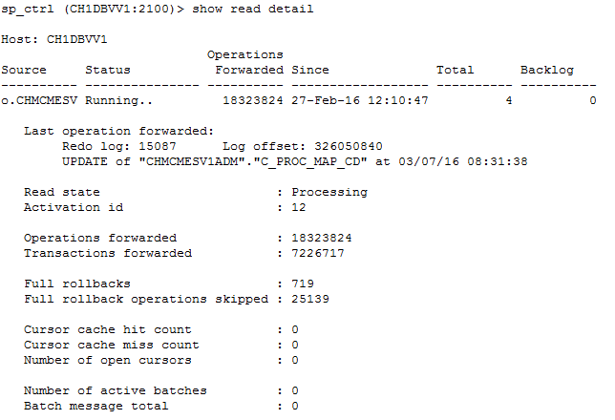
4. Read Process
Check Item | Details | Result
Read Process (Source) | sp_ctrl(source) > show read detail | [ OK ]
 | • Generally, the time In “Last operation forwarded section” should be close to the system current time. • The number of Backlog message should be less than 10000 messages

Slide 7
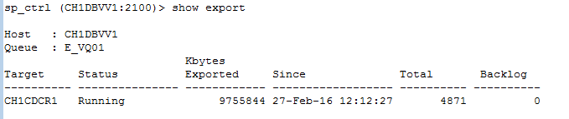
5. Export Process
Check Item | Details | Result
Export Process (Source) | sp_ctrl(source) > show export | [ OK ]
 | • If the status is 'Idle', check the network

Slide 8

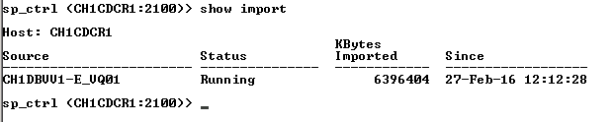
6. Import Process
Check Item | Details | Result
Import Process (Target) | sp_ctrl(target) > show import | [ OK ]
 | • If the status is 'Idle', check the network

Slide 9
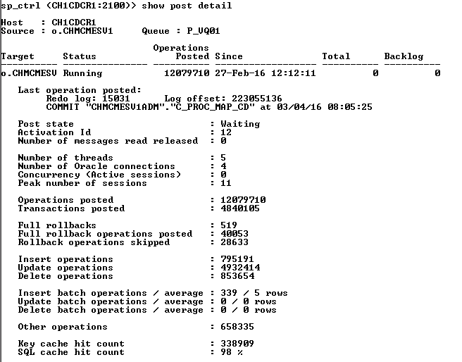

7. Post Process
Check Item | Details | Result
Post Process (Target) | sp_ctrl(target) >show post detail | [ OK ]
 | • Check the status is 'Running' • The time of 'Last operation posted' should be close to the current time • The number of DML(insert/update/delete) operations should be increasing

Slide 10
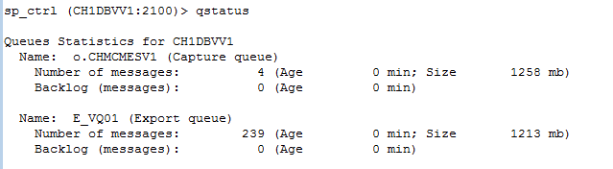

8. Queue
Check Item | Details | Result
Queue (Source) | sp_ctrl(source) > qstatus | [ OK ]
 | • Check the backlog • If a certain queue backlog has many messages, check the Event Log and DB Status • Generally in online transaction, the number of Backlog message should be less than 10000 messages
Queue (Target) | sp_ctrl(target) > qstatus | [ OK ]
 | • Check the backlog • If a certain queue backlog has many messages, check the Event Log and DB Status • Generally in online transaction, the number of Backlog message should be less than 10000 messages

Slide 11

9. Sync
Check Item | Details | Result
Sync (Target) | sp_ctrl(target) > show sync | [ ok]
 | • Check to see of there is any out-of-sync

